Slide 1
HTML Basic
v1.0

Slide 2
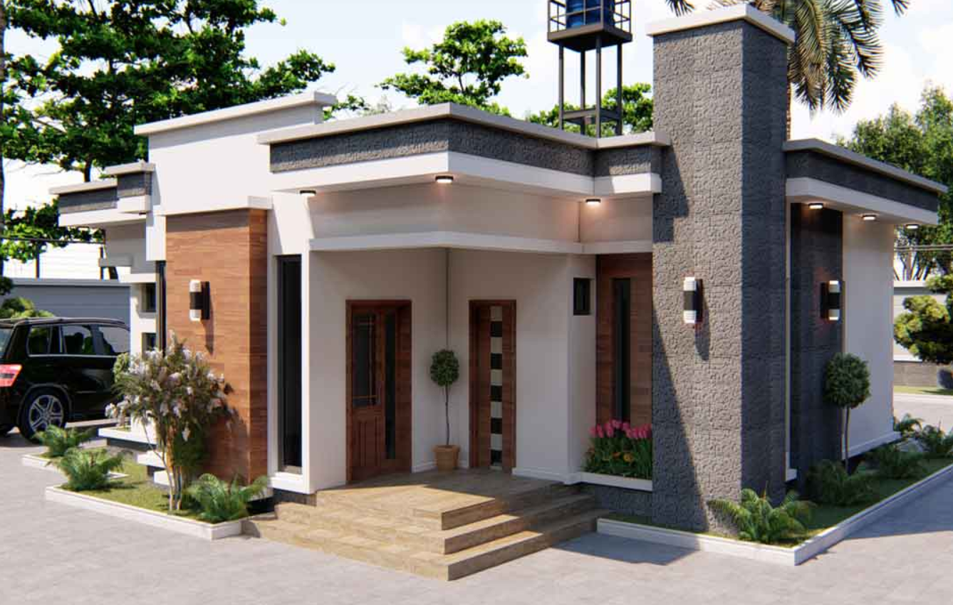
<!Doctype html>
HTML Basic
Version 1

Slide 3
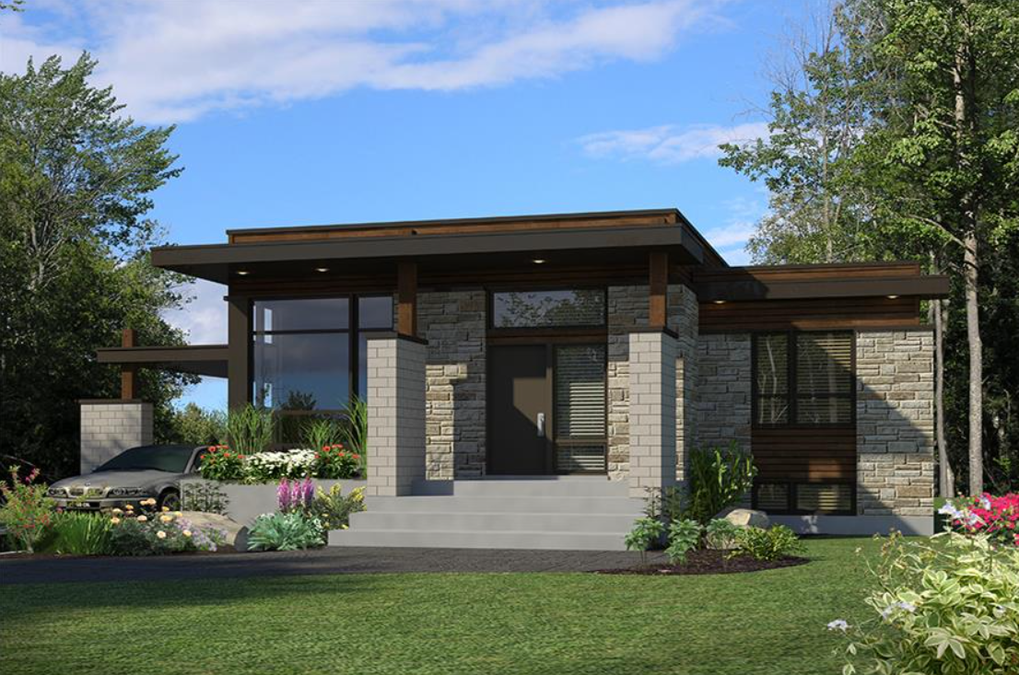
<!Doctype html>
HTML Basic
Version 2

Slide 4
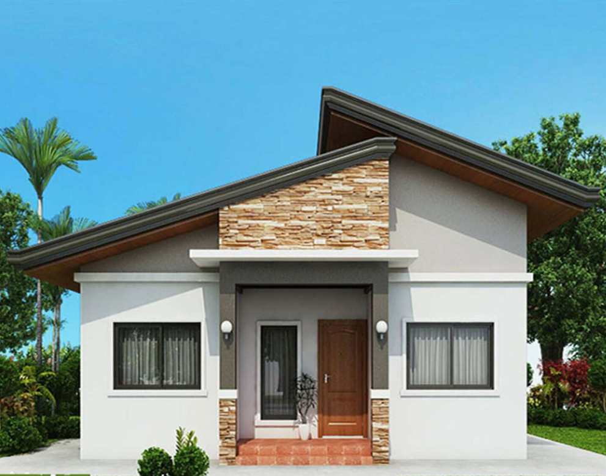
<!Doctype html>
HTML Basic
Version 3

Slide 5
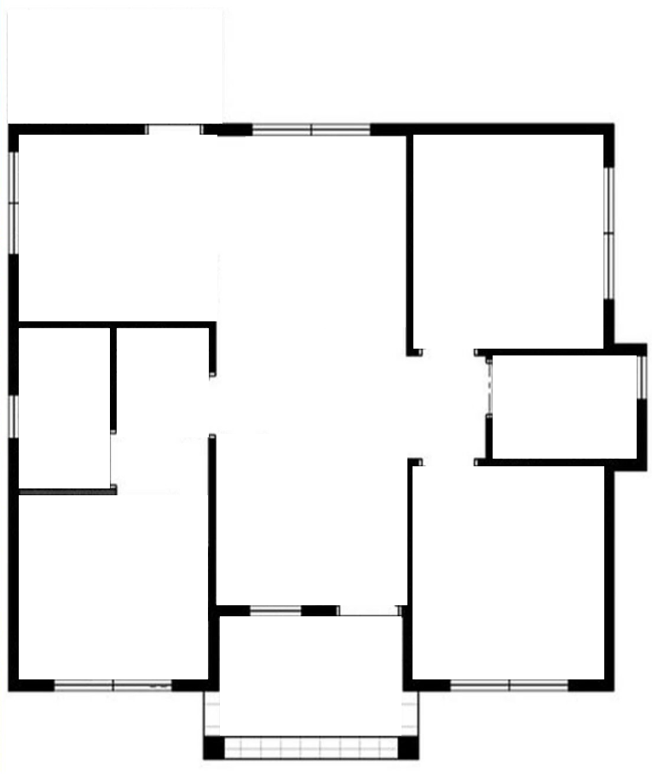
<html> </html>
HTML Basic
Structure

Slide 6
<head> </head>
HTML Basic
Information
3 Bedroom
Living Area Dining Area
Kitchen
2 Toilet
Laundry Area Porch

Slide 7
<title> </title>
HTML Basic
Title
Home Sweet Home

Slide 8
<body> </body>
X
HTML Basic
Parts
3 Bedroom
Living Area
Dining Area
Kitchen
2 Toilet
Laundry Area
Porch
NOT A GOOD PRACTICE

Slide 9
<body> </body>
HTML Basic
Parts
3 Bedroom
Living Area
Dining Area
Kitchen
2 Toilet
Laundry Area
Porch

Slide 10
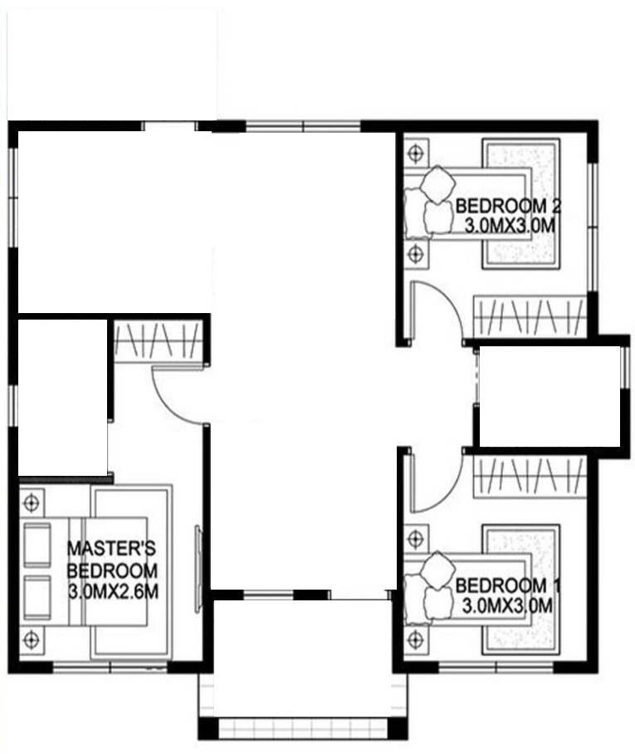
<body> </body>
HTML Basic
Parts
3 Bedroom
Living Area
Dining Area
Kitchen
2 Toilet
Laundry Area
Porch

Slide 11
<body> </body>
HTML Basic
Parts
3 Bedroom
Living Area
Dining Area
Kitchen
2 Toilet
Laundry Area
Porch

Slide 12
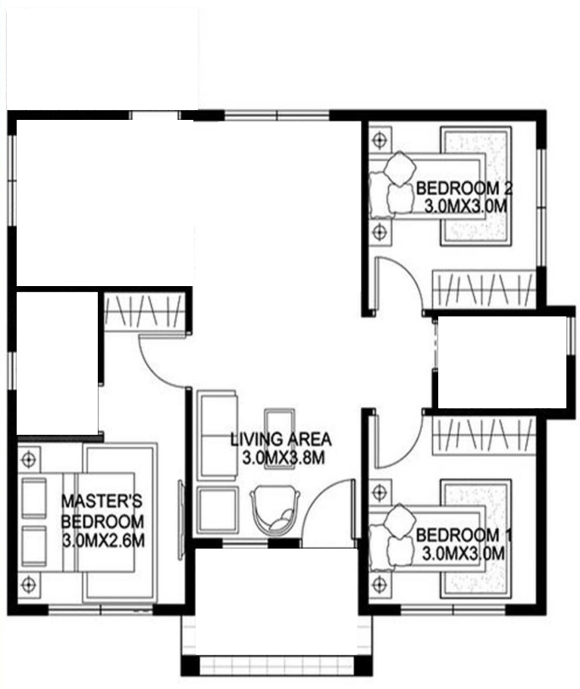
<body> </body>
HTML Basic
Parts
3 Bedroom
Living Area
Dining Area
Kitchen
2 Toilet
Laundry Area
Porch

Slide 13
<body> </body>
HTML Basic
Parts
3 Bedroom
Living Area
Dining Area
Kitchen
2 Toilet
Laundry Area
Porch

Slide 14
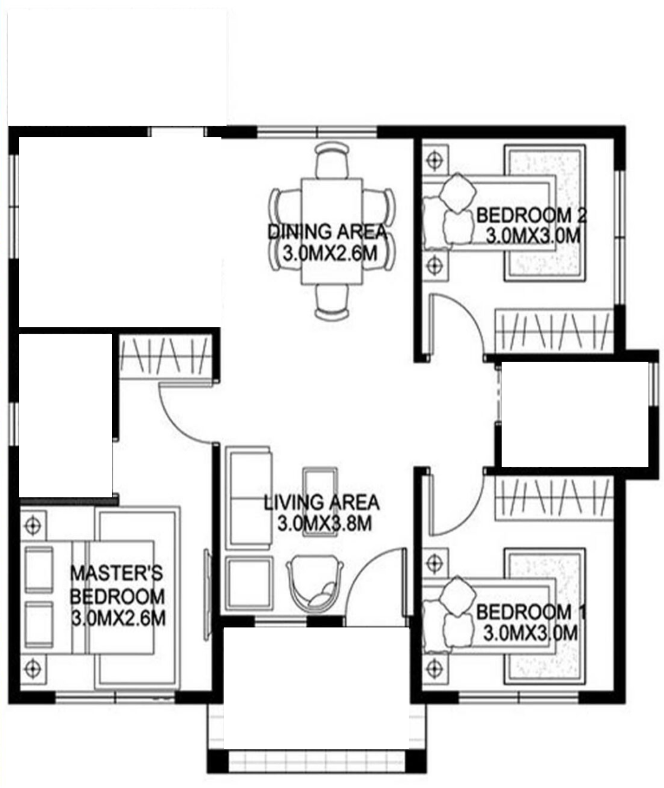
<body> </body>
HTML Basic
Parts
3 Bedroom
Living Area
Dining Area
Kitchen
2 Toilet
Laundry Area
Porch

Slide 15
<body> </body>
HTML Basic
Parts
3 Bedroom
Living Area
Dining Area
Kitchen
2 Toilet
Laundry Area
Porch

Slide 16
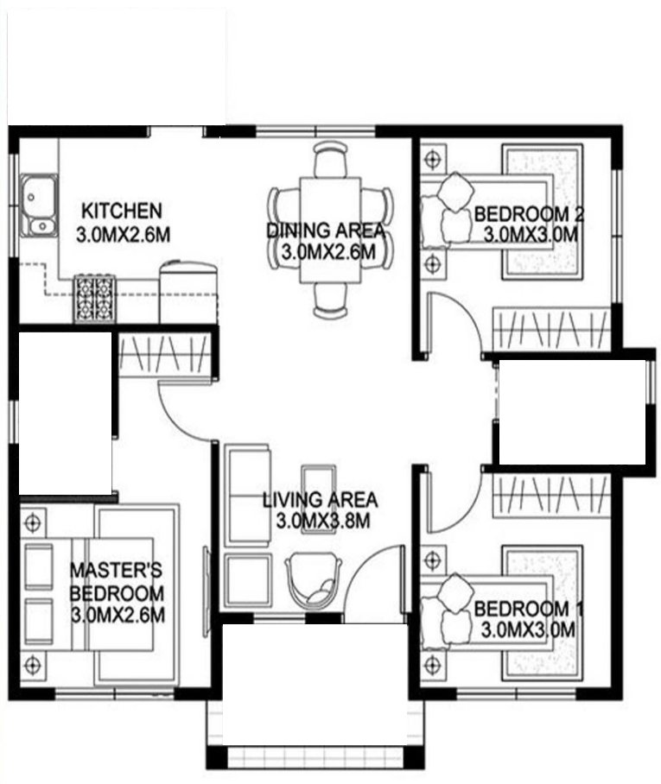
<body> </body>
HTML Basic
Parts
3 Bedroom
Living Area
Dining Area
Kitchen
2 Toilet
Laundry Area
Porch

Slide 17
<body> </body>
HTML Basic
Parts
3 Bedroom
Living Area
Dining Area
Kitchen
2 Toilet
Laundry Area
Porch

Slide 18
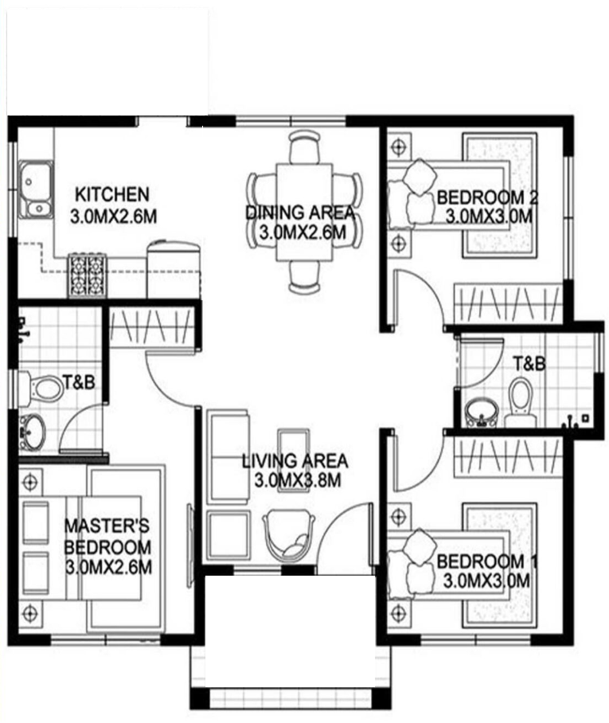
<body> </body>
HTML Basic
Parts
3 Bedroom
Living Area
Dining Area
Kitchen
2 Toilet
Laundry Area
Porch

Slide 19
<body> </body>
HTML Basic
Parts
3 Bedroom
Living Area
Dining Area
Kitchen
2 Toilet
Laundry Area
Porch

Slide 20
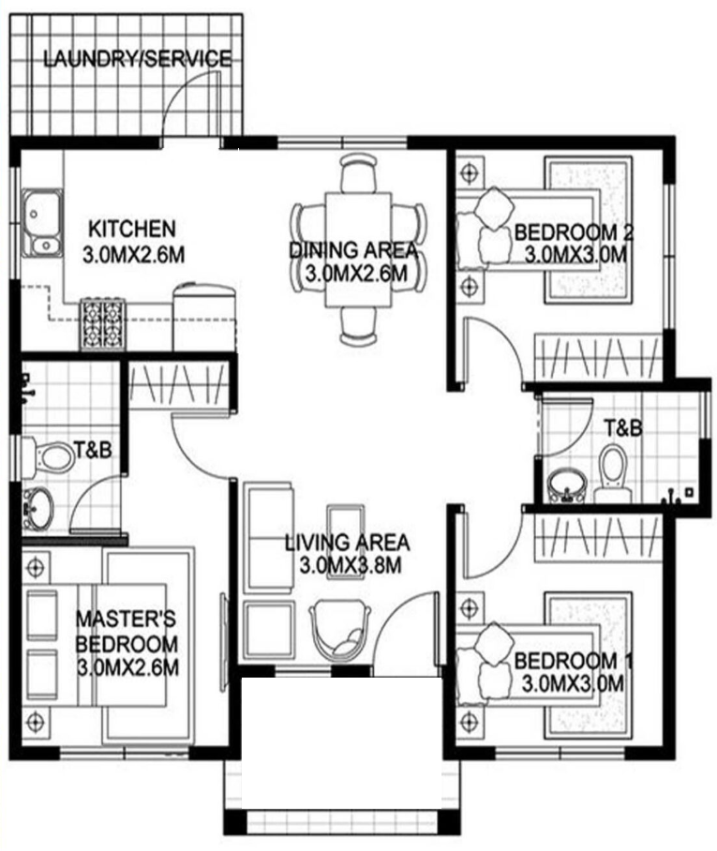
<body> </body>
HTML Basic
Parts
3 Bedroom
Living Area
Dining Area
Kitchen
2 Toilet
Laundry Area
Porch

Slide 21
<body> </body>
HTML Basic
Parts
3 Bedroom
Living Area
Dining Area
Kitchen
2 Toilet
Laundry Area
Porch

Slide 22

<body> </body>
HTML Basic
Parts
3 Bedroom
Living Area
Dining Area
Kitchen
2 Toilet
Laundry Area
Porch

Slide 23
Summary
HTML Basic
<!DOCTYPE html>
<html></html>
<head></head>
<title></title>
<body></body>

